Slide 1

On the Hunt for the Holy Graal:
One VM to rule them all?
Dr. Marco Bungart
Software Engineer
2019-09-25

Slide 2
Safe Harbor
The following presentation is intended to outline the features of GraalVM and basic use cases. Neither ConSol Consulting & Solutions Software GmbH nor Dr. Marco Bungart work for or with Oracle on the GraalVM project and are therefore not resposible to fulfill any primises made by the GraalVM project.
Features shown may be marked as „experimental“ or „technical previews“. They are subject to change and may never be delivered.
Opinions presented are my own and neither those of the GraalVM team nor those of ConSol Consulting & Solutions Software GmbH.
Notes:
Long-term customer relationships
open source
<number>

Slide 3

Another JVM?
What offers GraalVM?
Extendable Polyglot-capabilities
Native compilation
Lower memory footprint
Why use GraalVM?
Polyglot-capabilites
Better performance
When to use GraalVM?
Polyglot projects
Containerized Applications
Source: https://knowyourmeme.com
Notes:
Long-term customer relationships
open source
<number>

Slide 4
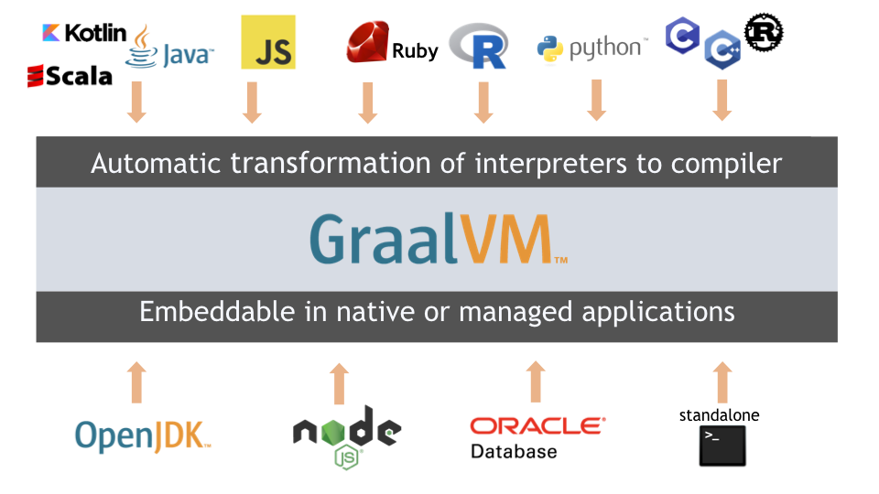
What: Internals of GraalVM
On a high abstraction level:
Source: https://www.graalvm.org/
Notes:
Long-term customer relationships
open source
<number>

Slide 5
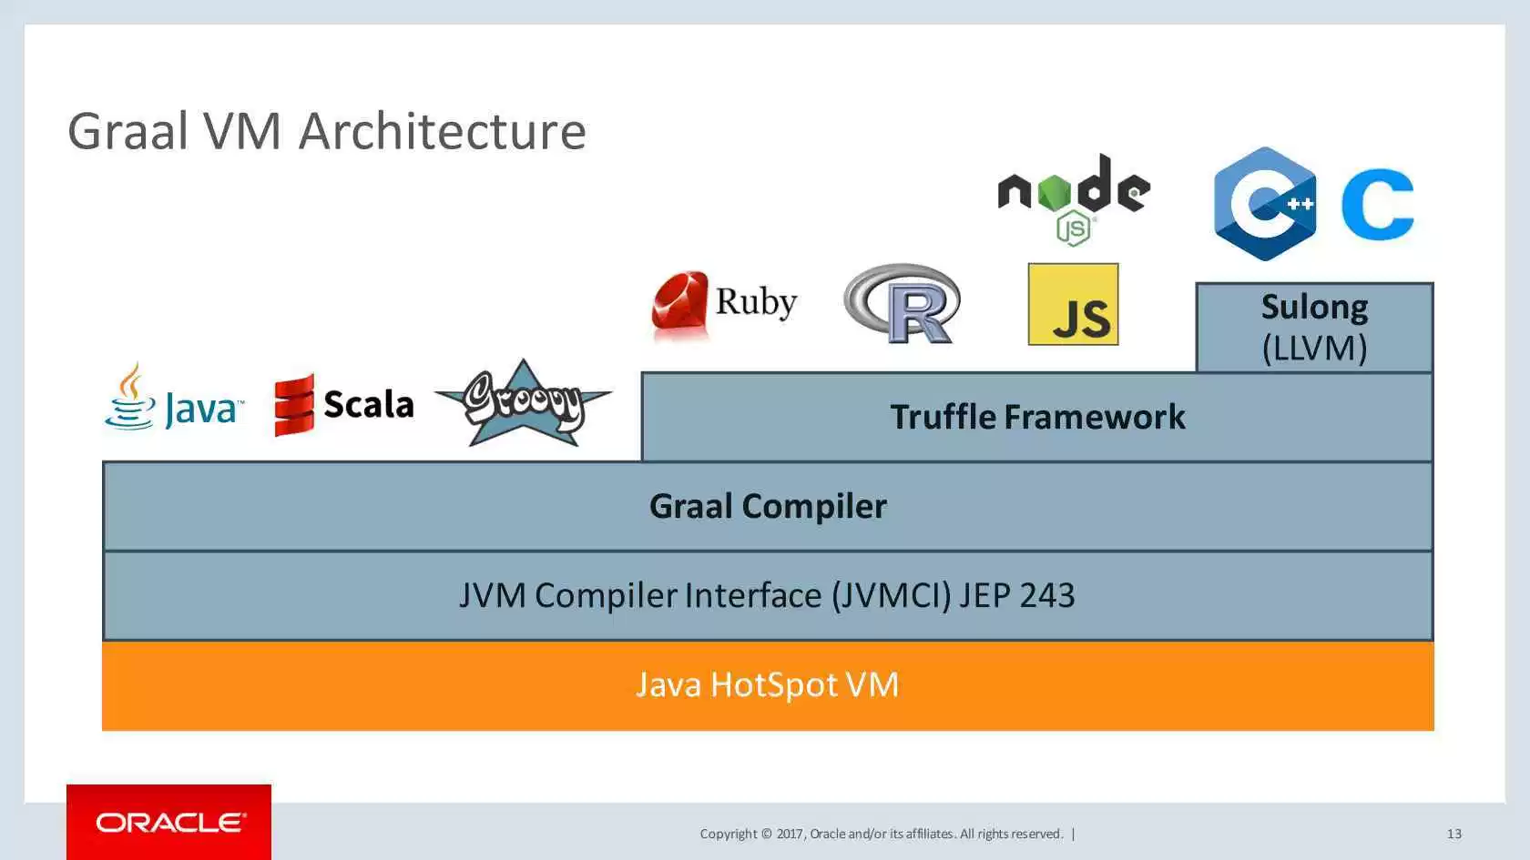
What: Internals of GraalVM
In more detail:
Source: https://jaxenter.de
Notes:
Long-term customer relationships
open source
<number>

Slide 6
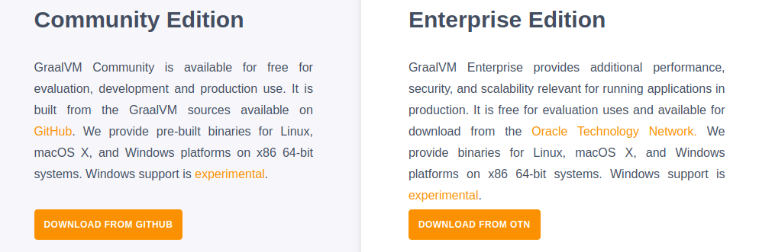
Licensing of GraalVM
Source: https://www.graalvm.org/downloads/
Notes:
Long-term customer relationships
open source
<number>

Slide 7



Why: benefits GraalVM?
Programming languages are tools in your toolbox
Performance improvement
Native compilation for containerization
Source: https://www.freepik.com
Source: https://insights.jmw.com
Source: https://www.docker.com
Notes:
Long-term customer relationships
open source
<number>

Slide 8
How: to use Polyglot with GraalVM?
Demo Time!
Notes:
Long-term customer relationships
open source
<number>

Slide 9
Performance of GraalVM
Notes:
Long-term customer relationships
open source
<number>

Slide 10
Native Compilation
Uses SubstrateVM
Closed-World assumption
Compilation is slow and memory intensive
Memory consumption lower
Guest-languages (JS, Python, …) are not compiled natively
Can compile binary with only static dependencies
Execution time is not at the core of optimization
Notes:
Long-term customer relationships
open source
<number>

Slide 11
Native Compilation
Notes:
Long-term customer relationships
open source
<number>

Slide 12
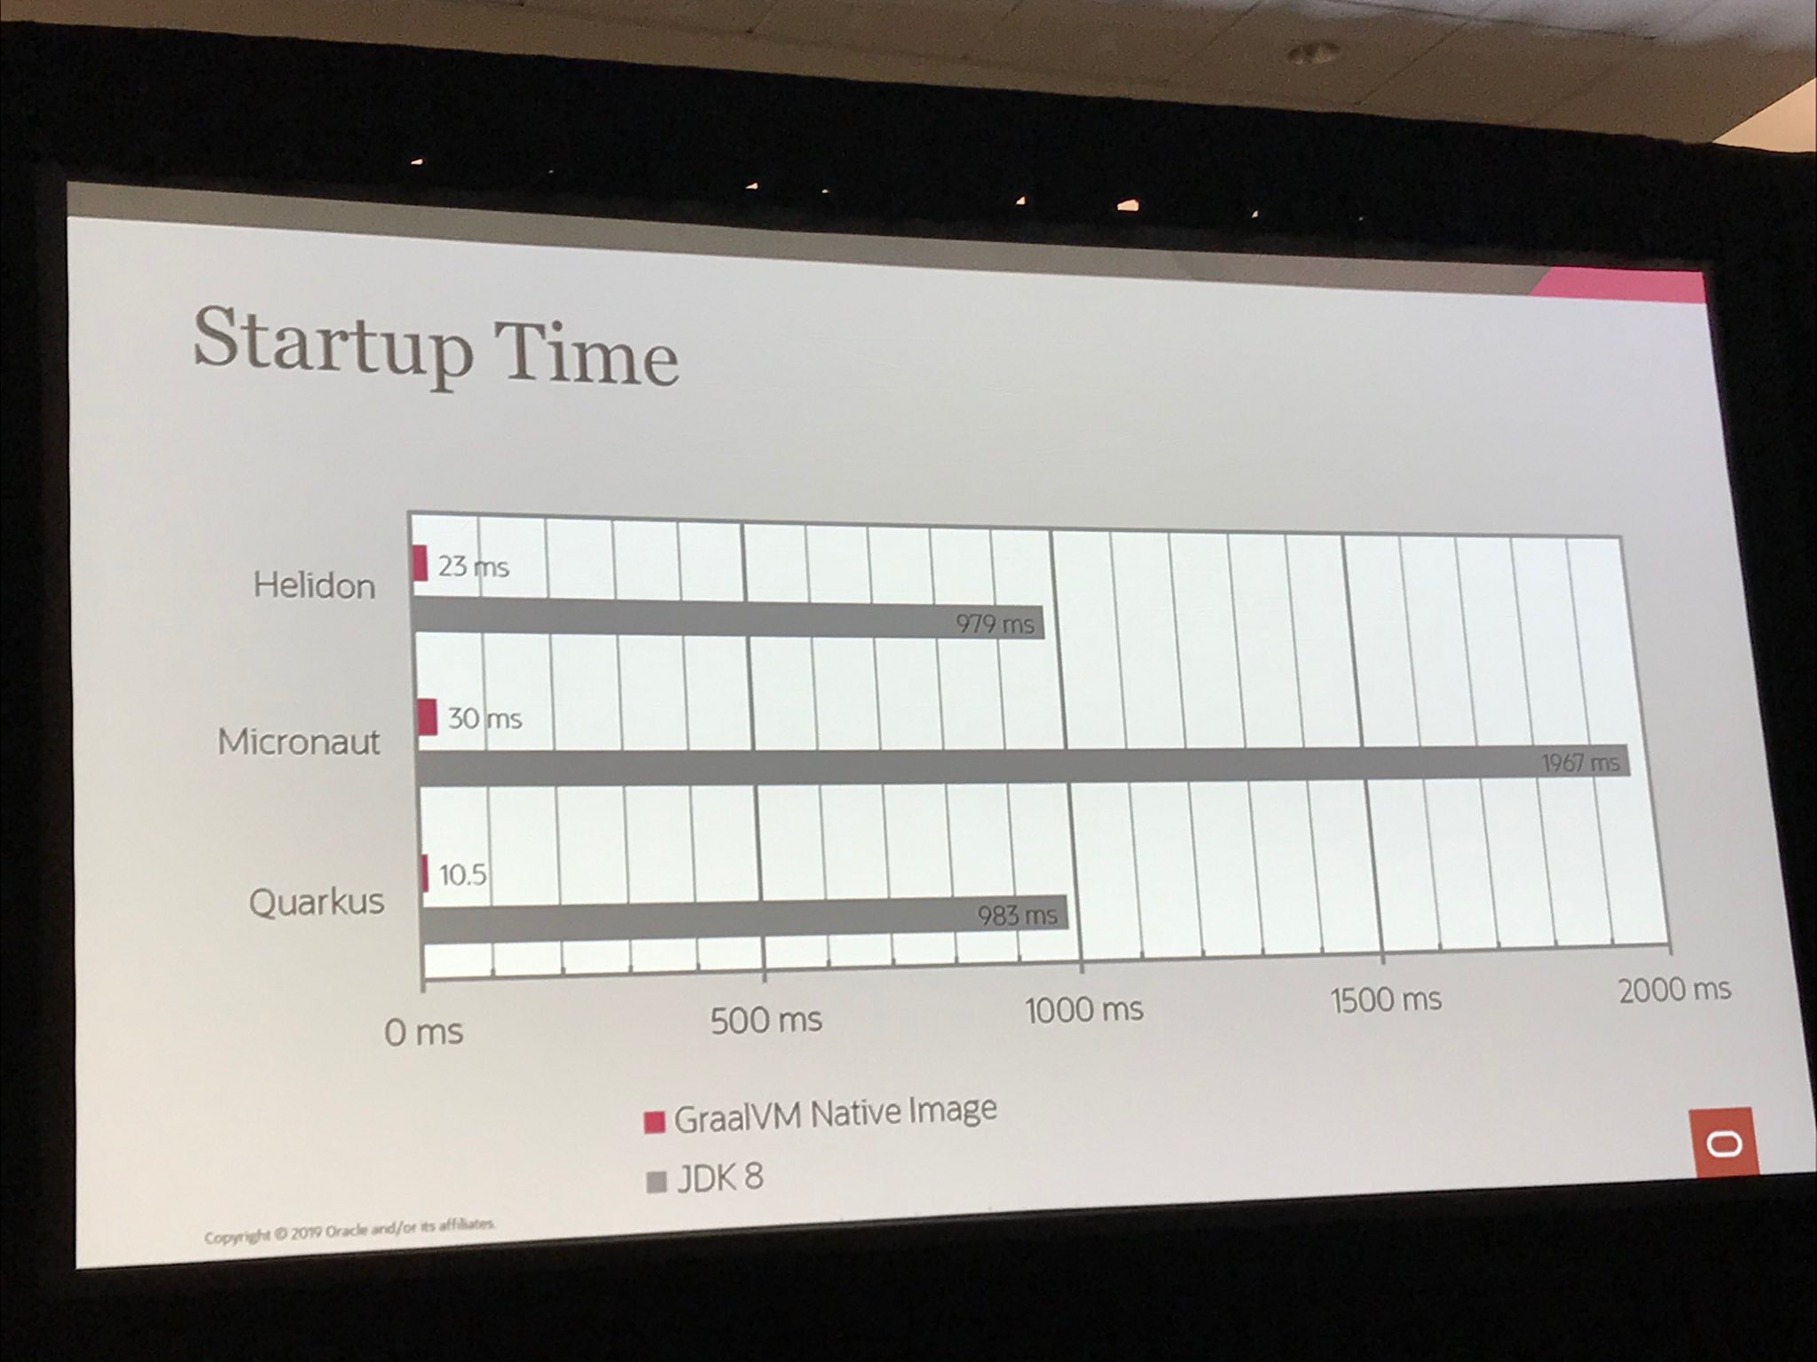
Native Compilation
Source: cesar_saavedr
Notes:
Long-term customer relationships
open source
<number>

Slide 13
Native Compilation
Demo Time!
Notes:
Long-term customer relationships
open source
<number>

Slide 14
References & Further Readings
Here at JCON:
Peter Palaga: Quarkus: Supersonic Subatomic Java (Cinema B, right here!)
References:
Interop & benchmark samples:
Polyglot javascript-R webserver: graalvm demos github repository
Spring native compilation: spring graal feature github repository
Further readings:
https://www.graalvm.org/docs/
Chris Seaton: Top 10 Things To Do With GraalVM
Notes:
Long-term customer relationships
open source
<number>

Slide 15
Thank You For Your Attention! Questions?

Slide 16

Dr. Marco Bungart
Software Engineer
Kanzlerstraße 8
D-40472 Düsseldorf, Germany
Phone: +49-211-339903-0
marco.bungart@consol.de
www.consol.com
Twitter: @turing85

